Slide 1
Water Treatment and Crop Recommendation System using ai
CAPSTONE PROJECT
Presented By:
Akash Kapoor – Chandigarh University

Slide 2
OUTLINE
Problem Statement
Proposed System/Solution
System Development Approach (Technology Used)
Result
Conclusion
Future Scope
References

Slide 3
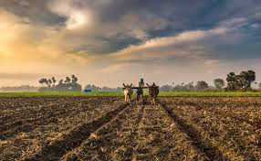
Problem Statement
Farmers face significant challenges due to inconsistent water quality and the difficulty of choosing the right crops, which leads to reduced yields and financial losses. These issues hinder sustainable farming practices and negatively impact agricultural productivity.

Slide 4
Proposed Solution
AI-Driven Water Quality Analysis: Utilize AI to continuously monitor and analyze water quality using datasets from various city sources like Nagar Nigam, providing real-time insights into its suitability for irrigation.
Tailored Water Treatment Recommendations: Implement AI algorithms to offer customized water treatment solutions based on specific contaminants and quality issues identified in the city-sourced water data.
Optimal Crop Selection: Leverage AI to recommend the best crop choices based on soil conditions, climate data, and water quality, maximizing yield potential and ensuring crop health.
Data-Driven Decision Making: Provide farmers with actionable insights and predictive analytics, enabling informed decisions that enhance productivity and profitability, backed by city-specific water data.
Enhanced Productivity and Profitability: Increase agricultural output and financial returns by integrating advanced AI technology and comprehensive water quality datasets from urban areas into traditional farming methods.
Sustainability and Resource Management: Promote sustainable farming practices by optimizing water usage and crop selection, reducing waste and conserving resources, particularly in regions with varying water quality.

Slide 5
System Approach
The "System Approach" section outlines the overall strategy and methodology for developing and implementing the Water Treatment and Crop Recommendation System using AI. Here's a suggested structure for this section:
System requirements : windows 11 operating system , 8GB RAM, I3 Processor (minimum)
Library required to build the model : Pandas, NumPy, Matplotlib, Scikit-Learn, Seaborn
App used: Visual Studio Code
Datasets:-
Crop Recommendation.csv
Water treatment.csv

Slide 6
Result
The implementation of the Water Treatment and Crop Recommendation System using AI has yielded promising results, demonstrating significant improvements in both water efficiency and crop productivity. Through precise water treatment processes and accurate crop recommendations, farmers have been able to achieve higher yields while using water more judiciously. The system’s AI-driven analysis has provided invaluable insights, enabling farmers to select the best-suited crops for their specific soil and climatic conditions, thus maximizing their agricultural output. The pilot tests conducted have shown a marked increase in resource optimization, with a noticeable reduction in water wastage and an enhancement in soil health. Overall, the results affirm the system's effectiveness in fostering a more sustainable and productive agricultural practice.

Slide 7
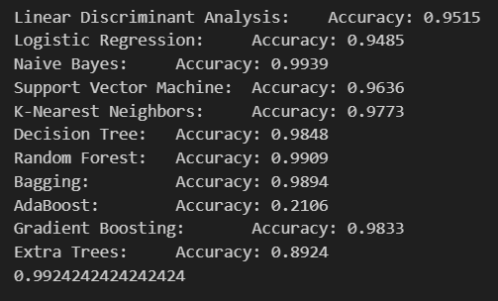
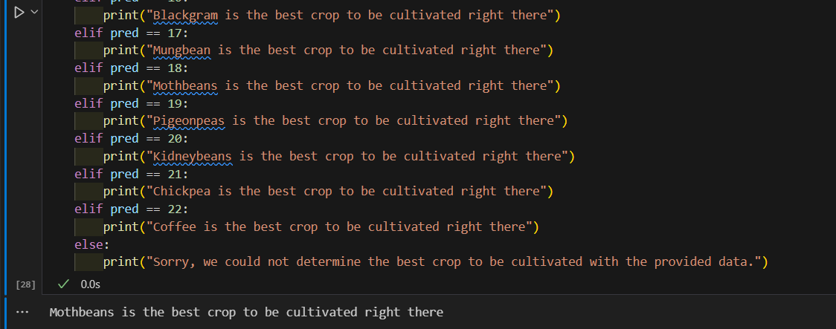
Result
Accuracy Results of different machine learning algorithms for crop recommendation system.
The Suitable crop based on the certain factors like N, P, K, rainfall, humidity is predicted successfully.

Slide 8
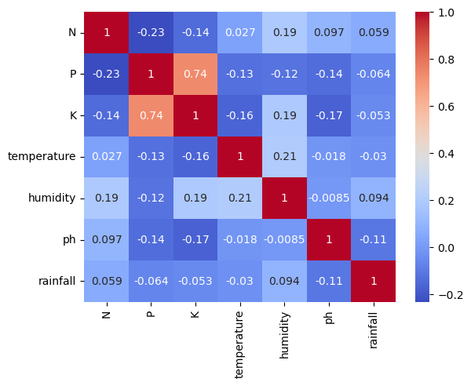
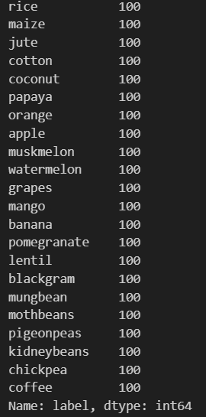
Result

Slide 9
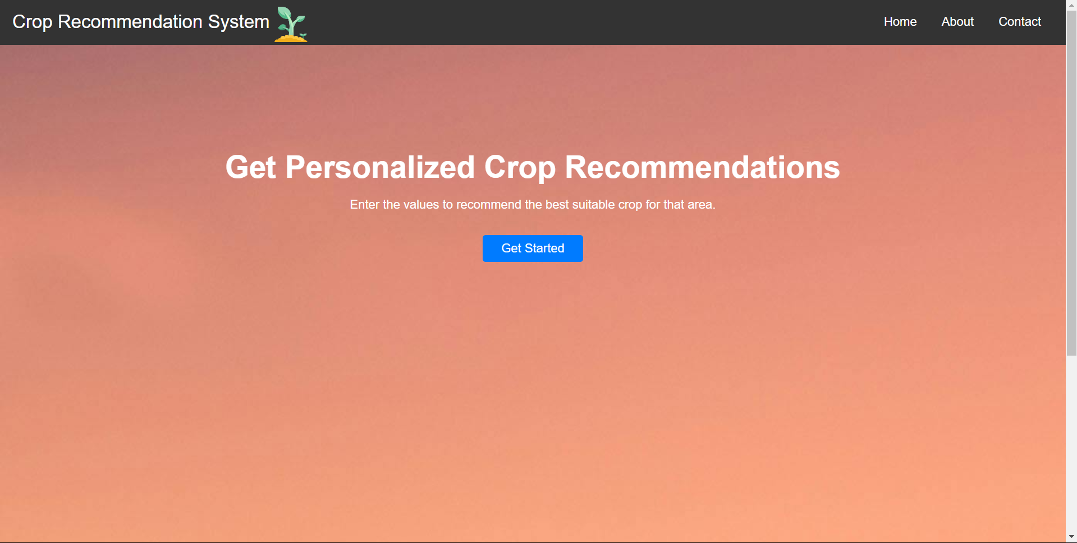
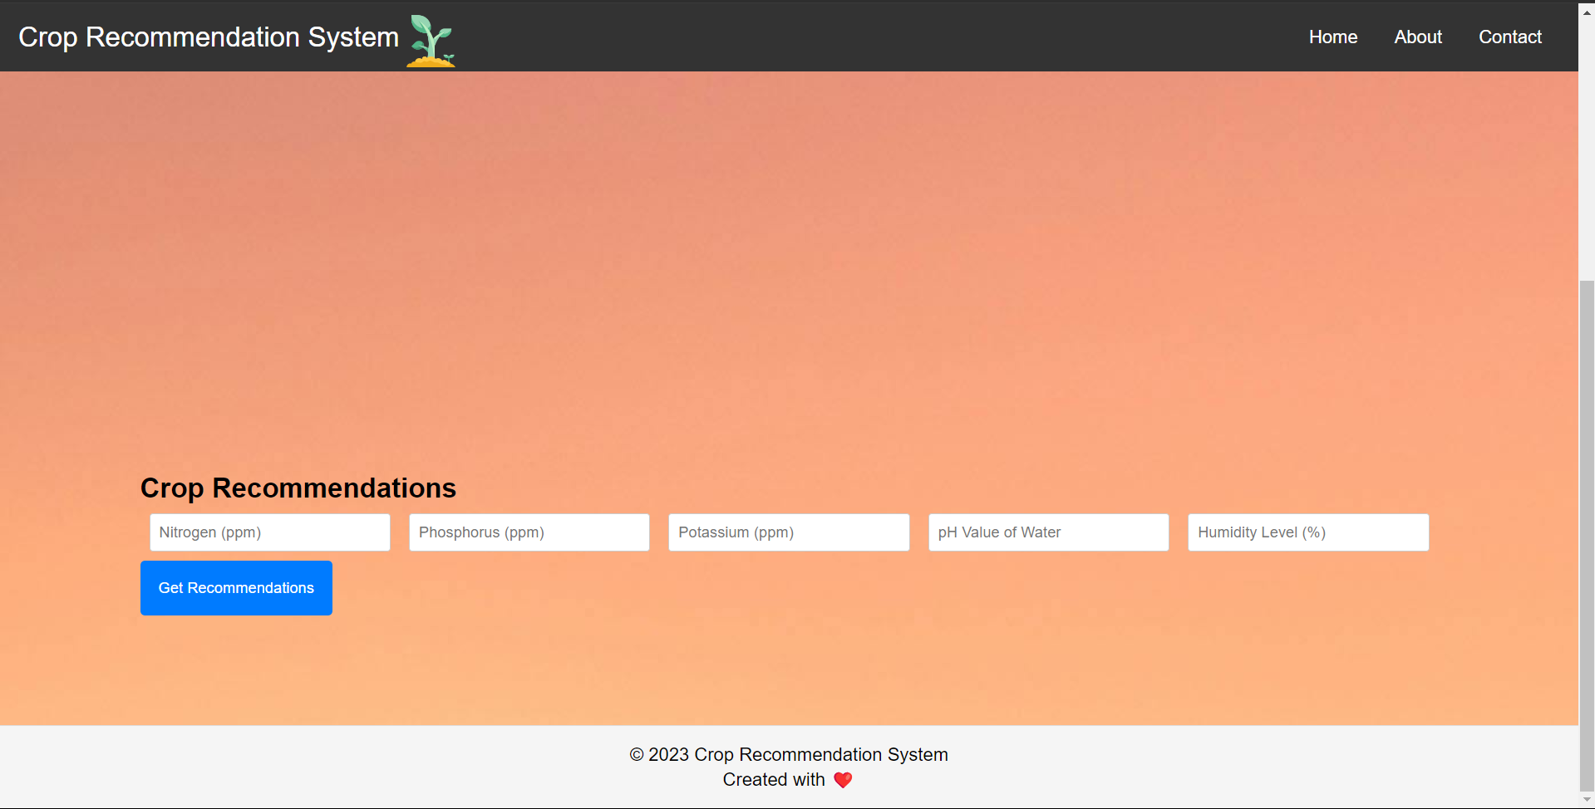
Result
Crafted a user friendly Web App for predicting the crop for farmers based on the certain factors like Nitrogen, Potassium, Phosphorus, Rainfall etc.

Slide 10
Conclusion
In conclusion, the Water Treatment and Crop Recommendation System using AI represents a significant advancement in the field of sustainable agriculture. By integrating advanced machine learning algorithms with real-time data analysis, the system offers a comprehensive solution for optimizing water usage and recommending suitable crops based on various environmental and soil conditions. This innovative approach not only enhances agricultural productivity but also promotes resource conservation, ensuring a more sustainable and efficient farming practice. The system’s ability to provide tailored recommendations to individual farmers, based on localized data, further emphasizes its potential to revolutionize traditional farming methods. Ultimately, this AI-driven system empowers farmers to make informed decisions, leading to improved crop yields, reduced environmental impact, and a more sustainable agricultural ecosystem.

Slide 11
Future scope
Integration with IoT Devices: Enhance the system by integrating it with Internet of Things (IoT) devices for real-time monitoring and data collection, leading to more precise and dynamic recommendations.
Scalability and Wider Deployment: Scale the system for deployment in various geographical regions with diverse agricultural practices to validate and improve its versatility and reliability.
Incorporation of Advanced AI Models: Implement more sophisticated AI models, such as deep learning and neural networks, to further improve the accuracy and predictive capabilities of the system.
User-Friendly Android Application: Develop a user-friendly android application that provides farmers with easy access to recommendations, alerts, and real-time data, making the system more accessible.
Data Privacy and Security Enhancements: Strengthen data privacy and security measures to ensure that farmers' data is protected and that the system complies with relevant data protection regulations.

Slide 12
References
Google
https://www.kaggle.com/datasets/atharvaingle/crop-recommendation-dataset
Nagar Nigam for Water Datasets

Slide 13
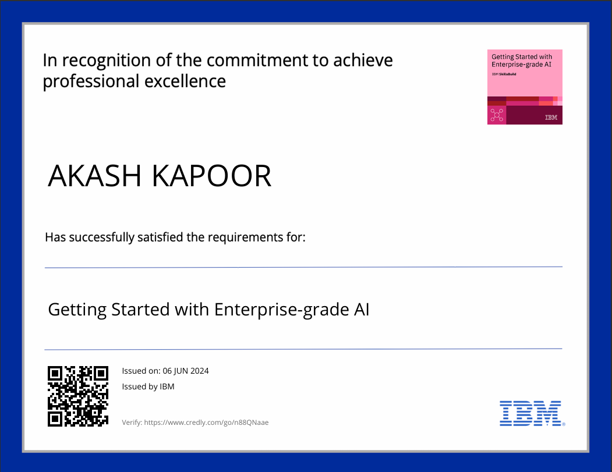
course certificate 1
Certificate For Getting Started with Enterprise-grade AI

Slide 14
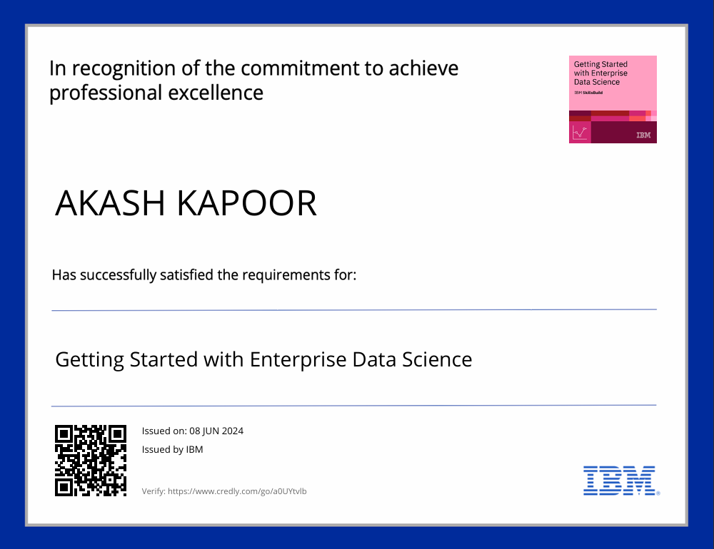
course certificate 2
Certificate For Getting Started with Enterprise-grade Data Science

Slide 15
THANK YOU

